Slide 1
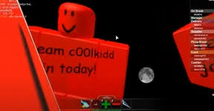
c00lkidd
C00lkidd was a hacker back then,he is knowned for creating c00lgui which is a hacking tool that can change sky box,add pictures to parts and more.He destroyed many servers and game the famous game that he hacked is Work At Pizza Place.Also he created a group named Team C00lkidd to TCK,the players that joined the group had admin in every game even if the game has no admin
Is c00lkidd a really a hacker well the answer is no he uses his gui to exploit on games and destroy them which leads to answer to no

